Slide 1
Setting up Python
Lucas Spellman

Slide 2
Overview
Background
  Virtual Environments
  Package Managers
  Shell/Terminal
Installation Walkthrough (Anaconda)

Slide 3
Background

Slide 4
Virtual Environments
Similar to Projects in R
  However, packages do not crossover
    This is a good thing!!
Few different types of Virtual environments
  Conda, pip, etc …
  Differences in backend of how these are managed and stored

Slide 5
Package Mangers
Manage packages and dependencies within each environment
  Good practice to keep environments separated/disentangled
    Isolates issues
Few examples of package managers
  Anaconda, pycharm (also an ide), virtualenv

Slide 6
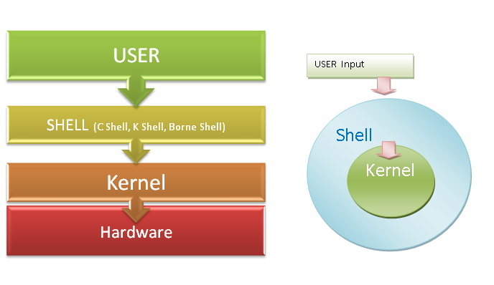
Terminology
Shell: interface/console that gives access to operating systems services
  Used for simpler tasks: ie making a folder or changing to a folder
  Also used to tell python what to do
Kernel: core of the operating system

Slide 7
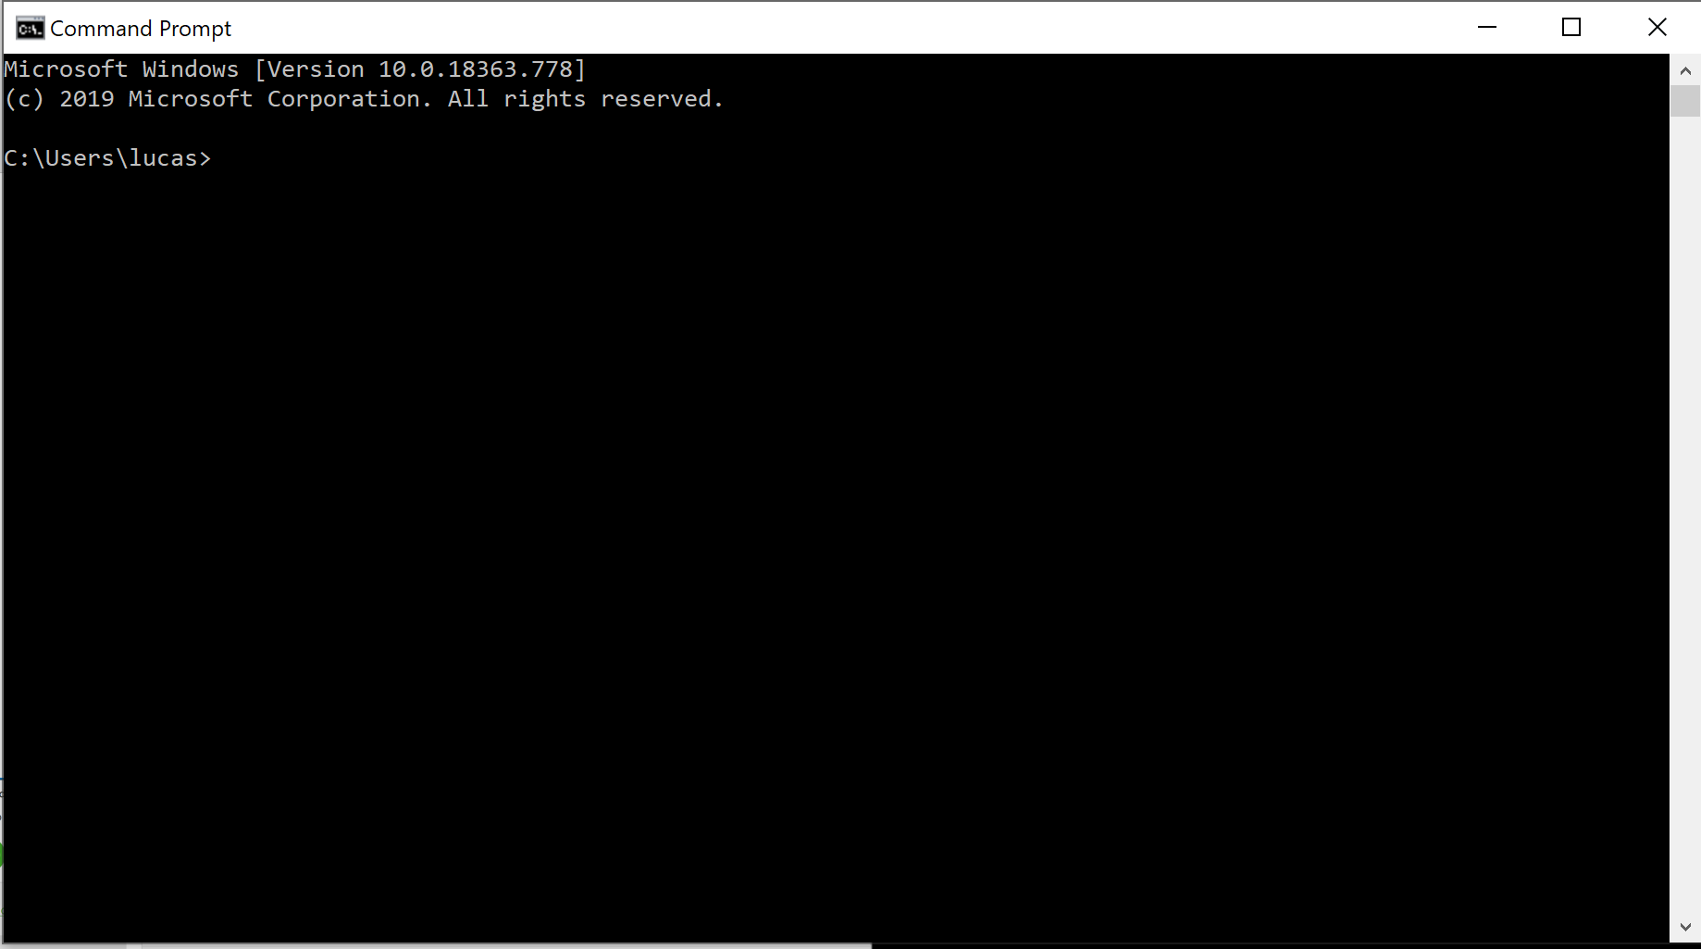
Opening a terminal
Windows :
  Search “cmd” into the search bar then click on program that pops up (should be command prompt)
  Or hit windows button and x, select windows powershell
Mac:
  Click the Launchpad icon in the Dock, type Terminal in the search field, then click Terminal.
  Or in the Finder , open the /Applications/Utilities folder, then double-click Terminal.

Slide 8
Installation Walkthrough

Slide 9
Prior to Installation
Do not install python before installing anaconda. Anaconda sets up python for you
  If you did install python already uninstall it

Slide 10
Installing Anaconda
Official Documentation for setup:
  https://docs.anaconda.com/anaconda/install/
Following the step by step instructions makes setup on mac or windows straightforward
  Mac also has a command line tutorial if you prefer that

Slide 11
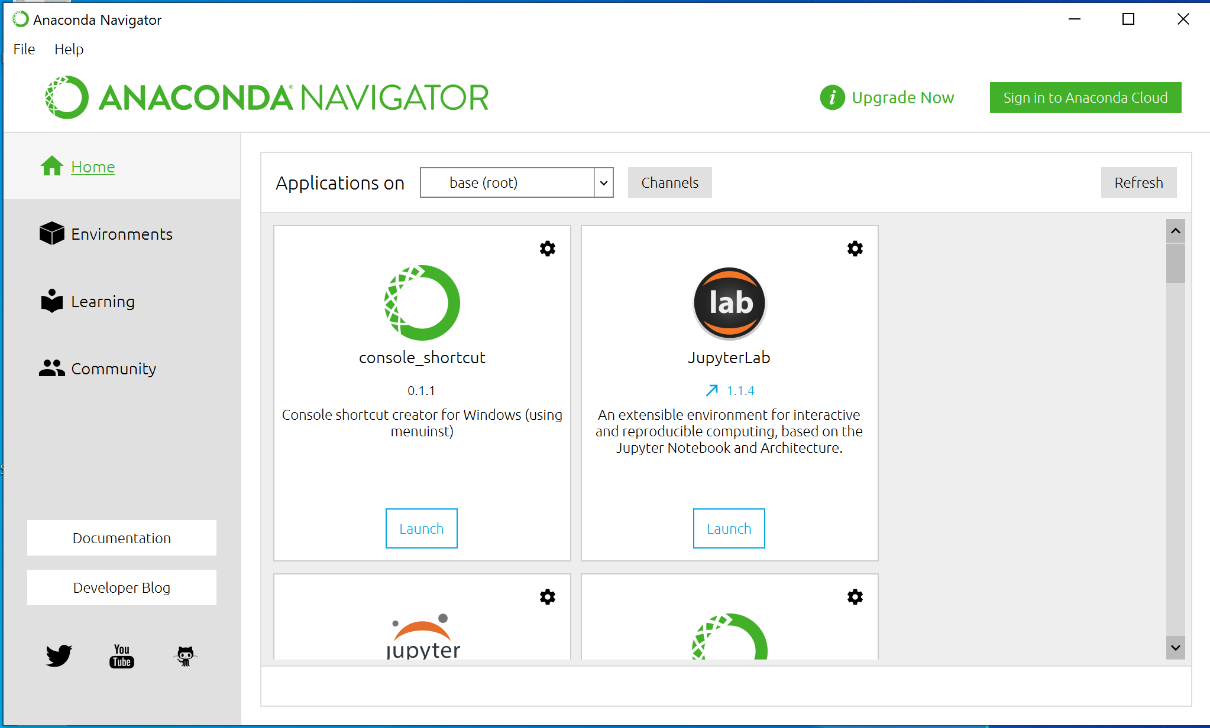
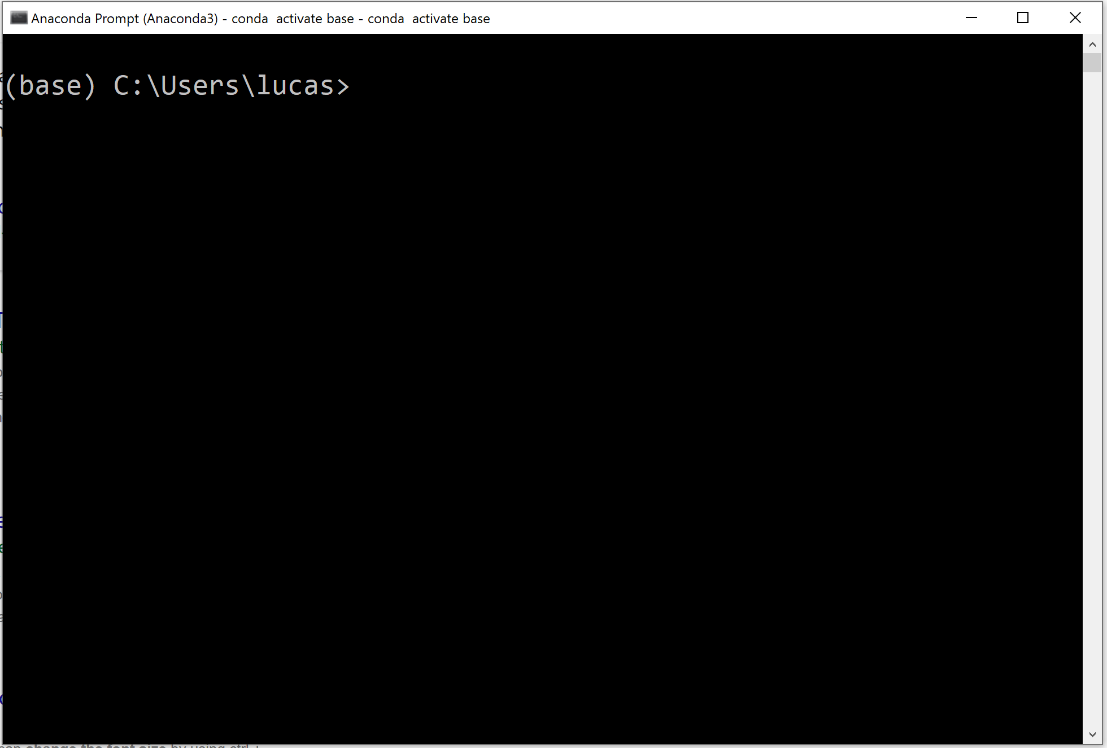
Anaconda
When you install anaconda you get two interfaces
  Anaconda navigator: a gui interface that allows you to access sub programs of anaconda (ways to run python and other programs is Jupyter Notebook, Spyder)
  Anaconda command prompt (and anaconda powershell) is essentially a shell with built in anaconda commands (allows you to install packages via conda, create virtual environments,…)
    Current directory is shown to the left of the arrow
    Current environment is shown to the left of the directory in parenthesis

Slide 12
Considerations/Tips I
Before doing anything
  Figure out where you want to store the program files
  Organize your folders
  Anaconda asks for a path to place the program files
    This does not mean you need to store all of your files in this folder. You can still store your files under documents or any other path
  My path (for anaconda):
    C:\Users\lucas\Anaconda3

Slide 13
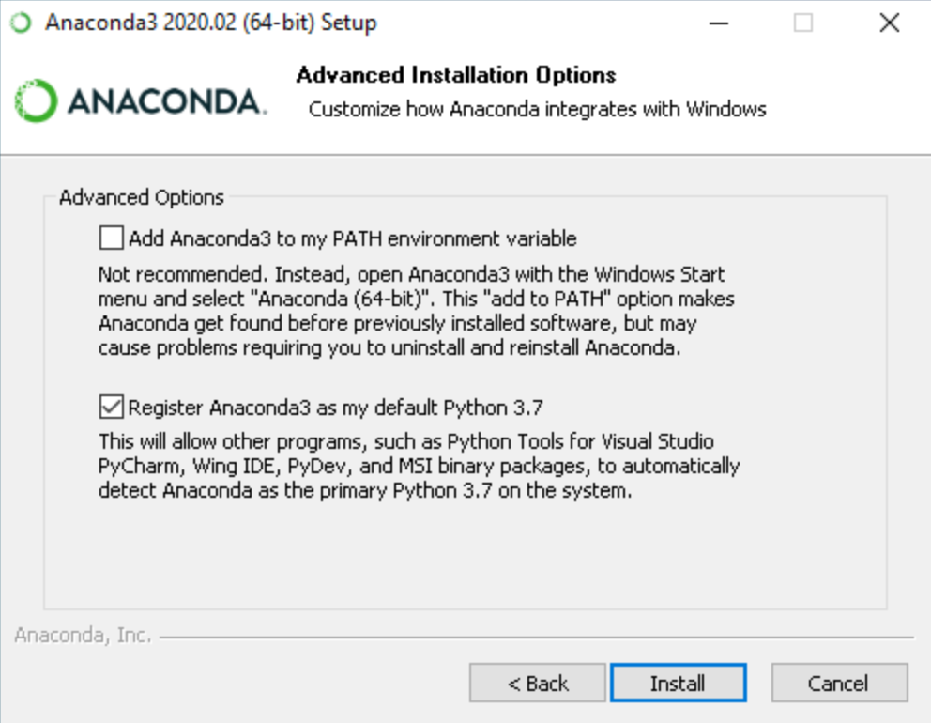
Considerations/Tips II
During installation:
  Do not add anaconda to your path! ( Usually pops up after you select folder destination)
  Allowing anaconda python to be your details makes it the baseline
    This can make things easier if it is the python you always use
    If it is not then it can cause problems finding the version of python you want

Slide 14
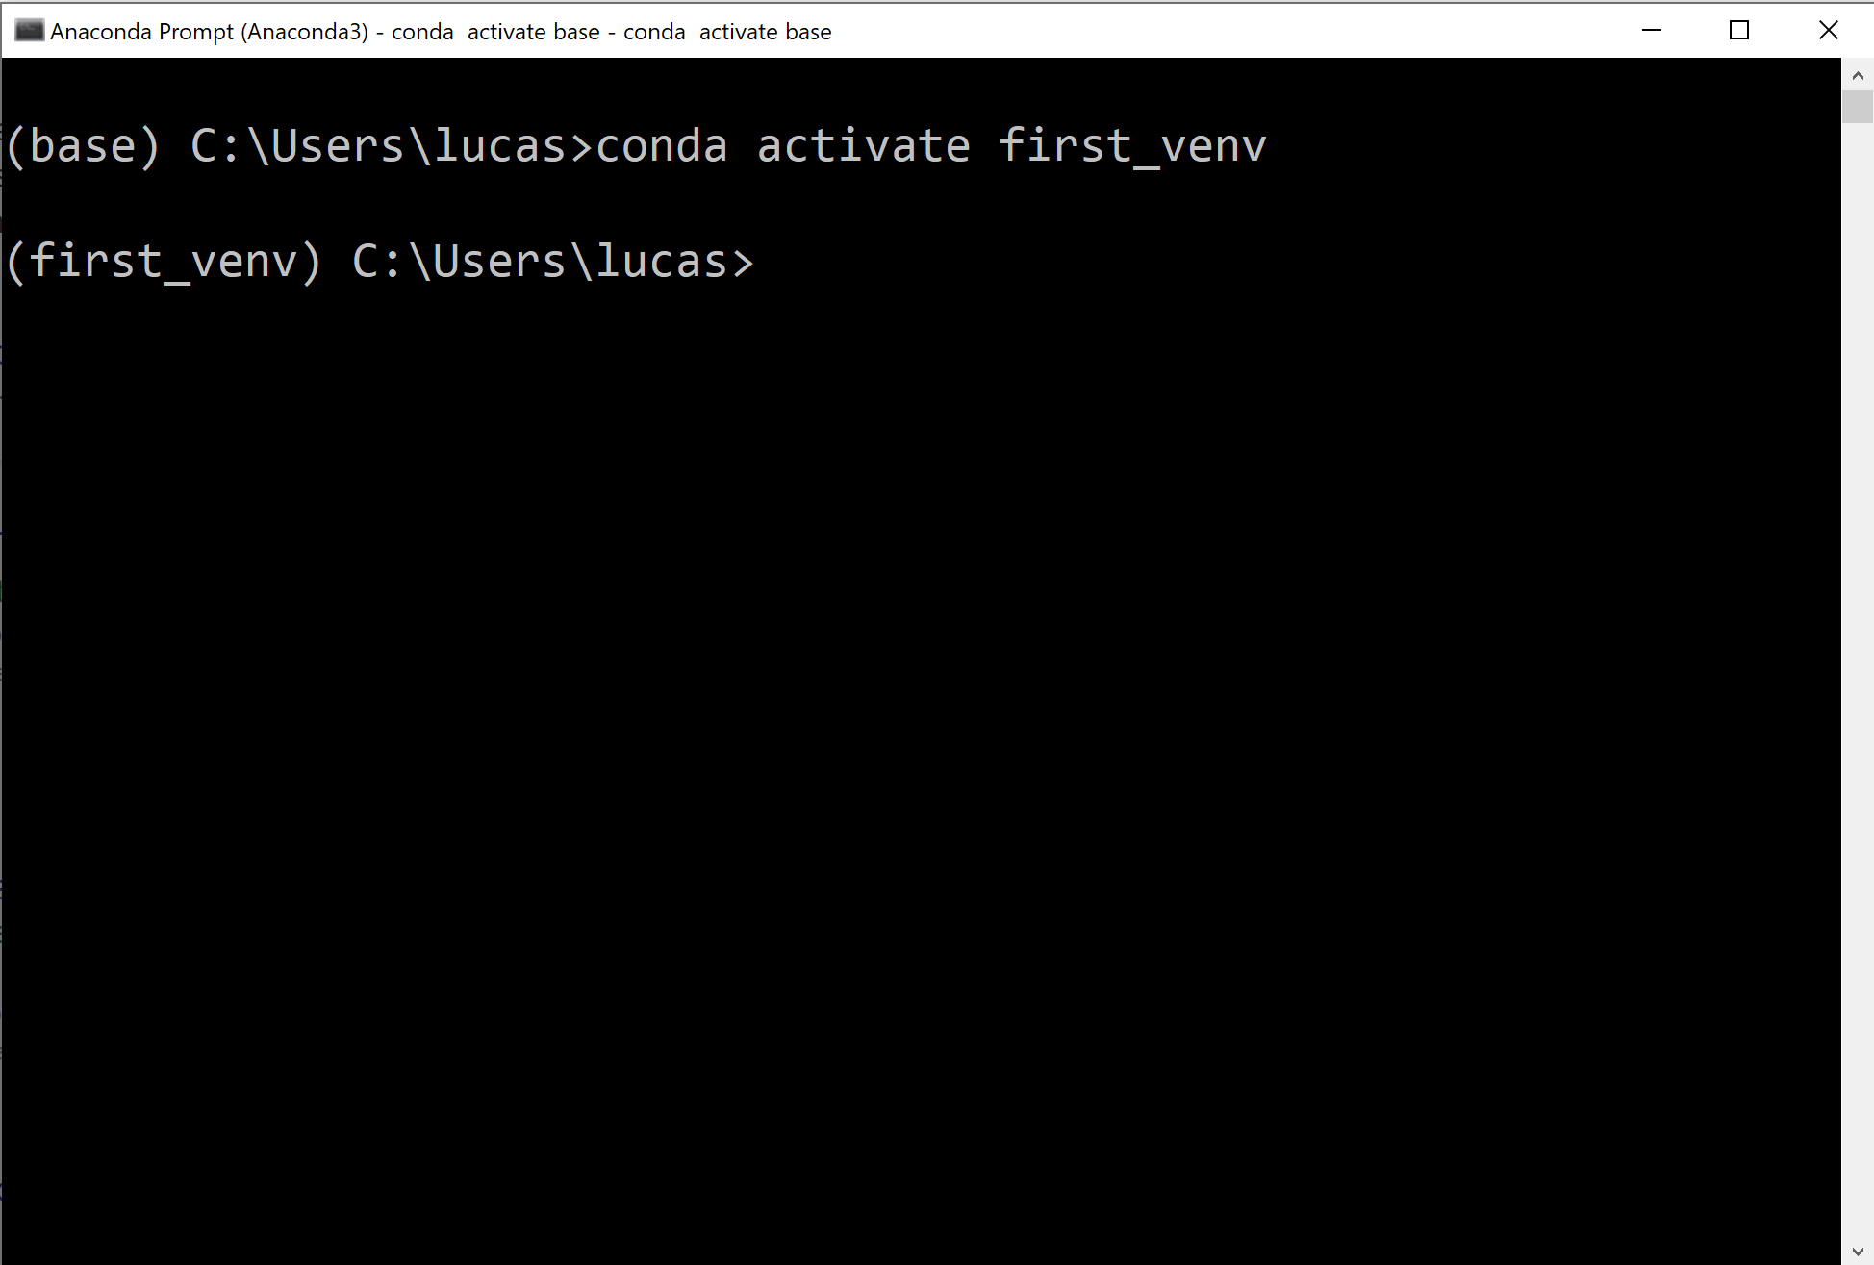
Considerations/Tips III
After installation
  Do not use the base environment (downloading a few packages here is fine)
    This is the “root” environment, everything branches off of it
      Any packages installed in this environment will be installed on new virtual environments
  Create a new virtual environment (via conda in the anaconda prompt)

Slide 15
Considerations/Tips IV
In general
  Get familiar with basic shell commands
  These are different between linux/mac and windows
    Can just type help into the terminal to get a list of commands

Slide 16
Creating a Virtual Environment via Conda
Open up the anaconda powershell or the anaconda prompt
  This is a custom shell anaconda installs for you. It gives you access to anaconda commands
Run “conda env list”
  Do not need “”; this list the environments you have installed
  Initially you will only see base
Run “conda create -n <environment_name>”
  Replace <environment_name> with the name you want (do not need <>)
Run “conda env list” to see the created environment
  Install packages into this environment and use it as your default

Slide 17
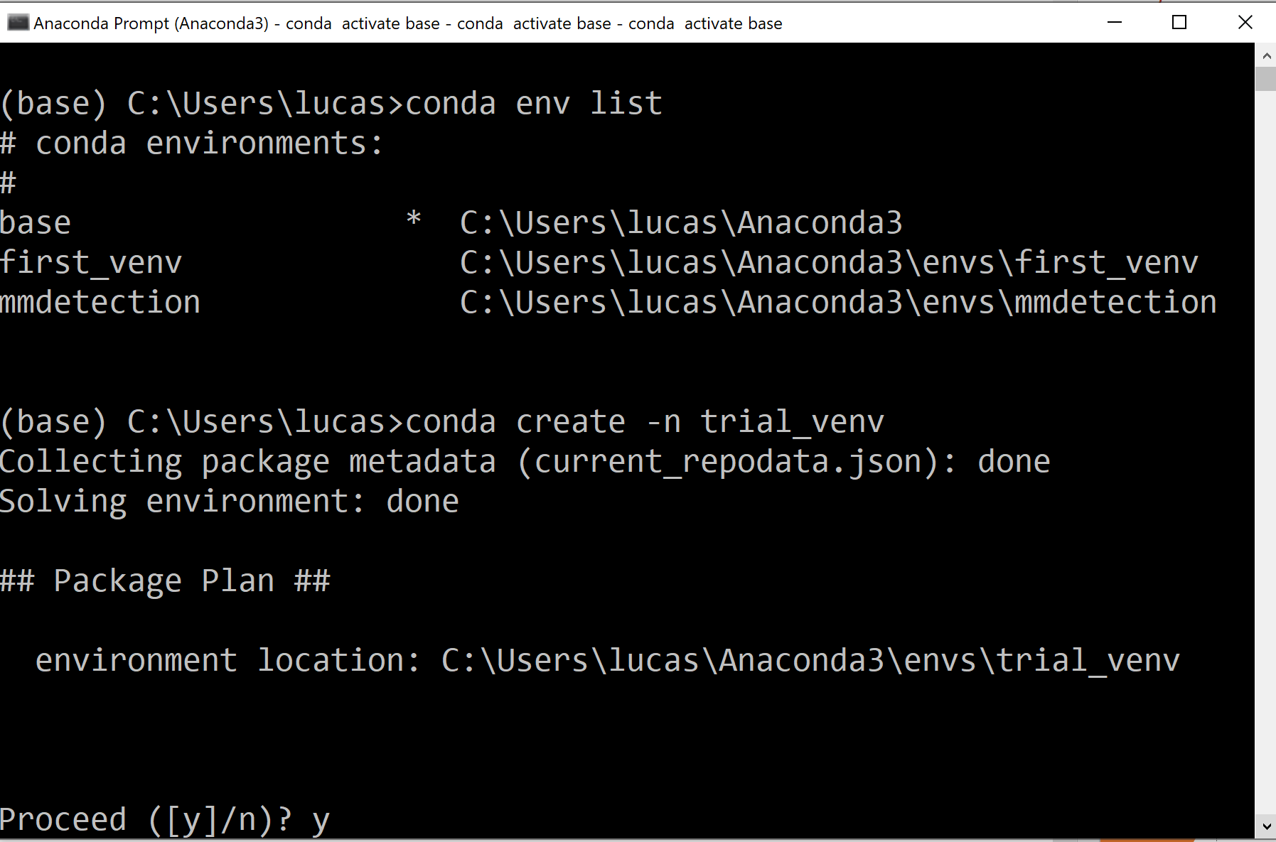
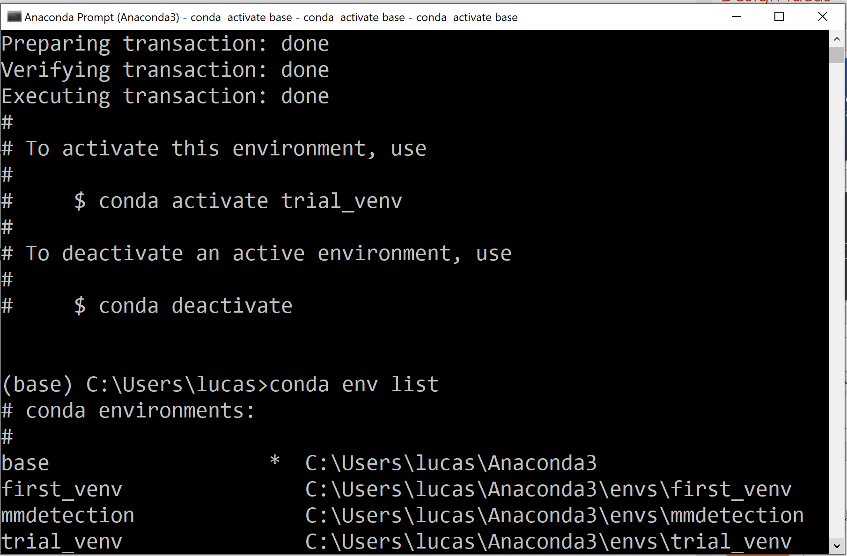
Ouput from Terminal

Slide 18
Jupyter notebook
Jupyter Notebook comes installed with anaconda
  This is a convenient notebook style way to use python
You can control which kernel this online version of python will use
  This simply means you can control which environment the notebook uses
  In order to do this some extensions are required:
    nb_conda should install everything you need
    nb_conda_kernels and ipykernel might also be needed
    After installing you will be able to specify the kernel when you make a new notebook

Slide 19
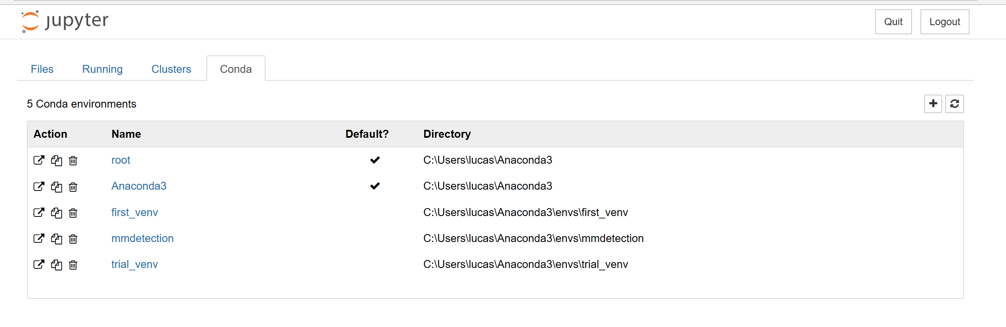
Jupyter Extension
With successful installation, a conda tab will be available otherwise the installation was unsuccessful

Slide 20
Resources
Anaconda documentation:
  https://docs.anaconda.com/anaconda/install/

